Slide 1
Monetizing flutter app
with Google AdMob
Pascal Stephan - TINF18B4

Slide 2
Table of contents
Google Firebase
Google AdMob
What you need
Implementation
Notes:
firebase:
helfen webapps und mobile apps zusammenzubringen und gemeinsam features zu benutzen und benutzerdaten zu sammeln
build: unterstützung bei entwicklung
quality: unterstützung nach realease
business: business methoden
kann für verschieden projekte genutzt werden:
web
mobile
free: nutzungskontingente für verschiedene Funktionen, analyticsdaten kostenlos

Slide 3

Google Firebase
A comprehensive app development plattform by Google
Many functions separated in three categories:
Build
Quality
Business
Notes:
firebase:
give you a big amount of features to use in your applications
build: cloud storage, authentication
quality: crashlytics, performance monitoring
business: google analytics, in-app messaging

Slide 4
Google Firebase
Where to use:
Web
Angular
React…
Mobile
Ionic
Flutter…
Free version have a limited usage contingent on every feature
Notes:
kann für verschieden projekte genutzt werden:
web
mobile
free: gather user data with analytics is free, if you want to use the other features you can use them for free but are limited with a usage contingent what means if you want to use it for bigger projects you have to pay

Slide 5
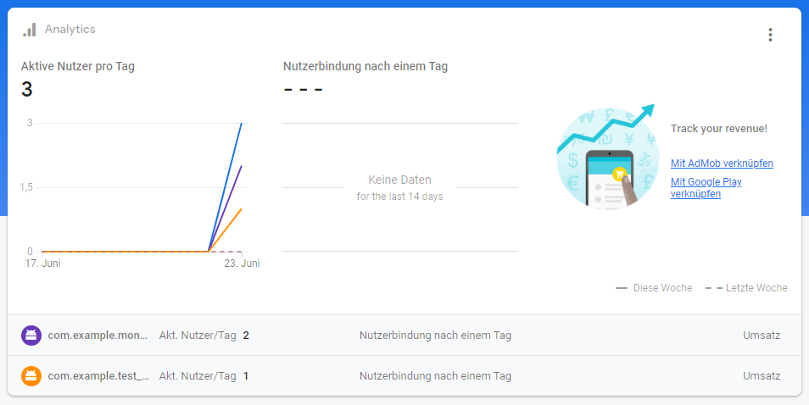
Google Firebase
Notes:
kann für verschieden projekte genutzt werden:
web
mobile
free: gather user data with analytics is free, if you want to use the other features you can use them for free but are limited with a usage contingent what means if you want to use it for bigger projects you have to pay

Slide 6

Google AdMob
One of the biggest advertising networks worldwide
Show Ads in your app and earn money
Costs:
Free to use for developers
CPC for advertisers
Notes:
AdMob:
one of the biggest advertising networks
creating ads to implement in your app
earn money if users click on the see or click on the ads
free for developers
advertisers pay to get advertising space in admobs created ads
they dont have to pay only to show their ads, they have to pay if someone clicks on their ads

Slide 7
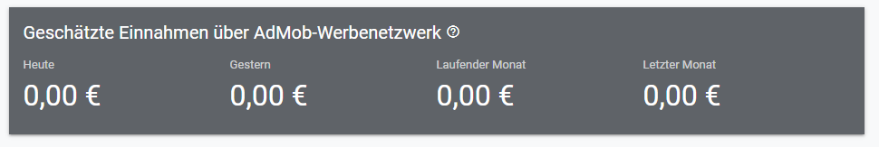
Google AdMob
Notes:
AdMob:
one of the biggest advertising networks
creating ads to implement in your app
earn money if users click on the see or click on the ads
free for developers
advertisers pay to get advertising space in admobs created ads
they dont have to pay only to show their ads, they have to pay if someone clicks on their ads

Slide 8
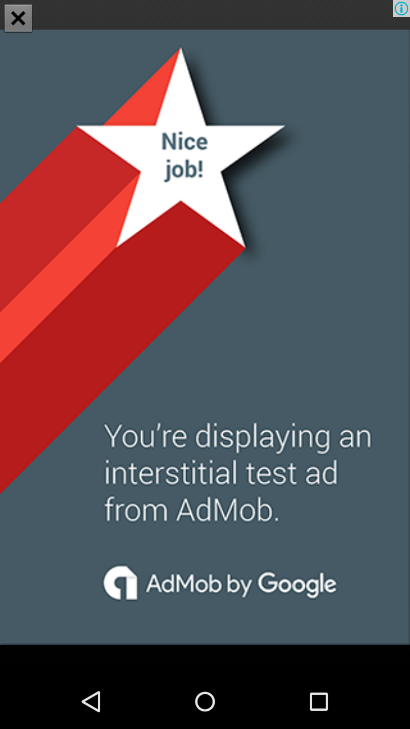
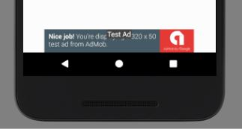
Google AdMob
Different display formats for ads:
Rewarded ads
Native ads
Banner
Interstitials
InterstitialAd
BannerAd
Notes:
ads:
four types of ads with admob:
rewarded ads
if user clicks or watch them they can gather points or something else
native ads
this ads adapt to the look of your app
banner
ads in rectangular format that cover a part of the display and after a specific amount of time get updated automatically
interstitials:
ad that covers the whole screen and can be used after pushing a specific button etc

Slide 9
What you need
Working IDE
Dart & Flutter
(Android Studio)
(Firebase account)
AdMob account
firebase_admob package
Notes:
Working IDE.
I use IntelliJ
Dart&Flutter:
Installation guide in readme
Android Studio:
if you dont want to use your phone you need an emulator. With android studio you can emulate nearly every phone. To use your smartphone you need to connect phone to pc and enable usb debugging
Firebase:
For my implementation with testads you dont need a firebase account but if you want to earn money with your app its useful to connect your app and admob to firebase to improve your ads based on user data
AdMob:
Create Ads that will be displayed. To implement ads you need an appid to identificate your app and adunitid to identificate which ad will be displayed. Both you will get from admob
firebase_admob package:
this package brings everything you need to implement ads in your app. Functions...

Slide 10

Implementation
Create AdMob account
Register your app: https://apps.admob.com/
Save your generated appID
AndroidManifest changes
Add following snippet and put in your appID from AdMob
Notes:
First we need to go to admob and register our app
the generated appid should be saved for later
after doing this we can go to our project
i created a default project with nothing on it apart from an appbar at the top
first we go to the androidmanifest.xml and put in this snippet
then we add our appid from admob

Slide 11
Implementation
Import firebase_admob package
Go to pubspec.yaml
Put firebase_admob: to dependencies
Import package to main.dart
Start creating your first ads
BannerAd
InterstitialAd (You will find the instruction for this ad in the ReadMe of my GitHub repo)
Notes:
next we go to the pubspec.yaml and add the dependencie for our package
after doing this we go to the main.dart and click the dependencies
now we can start to program the ads

Slide 12
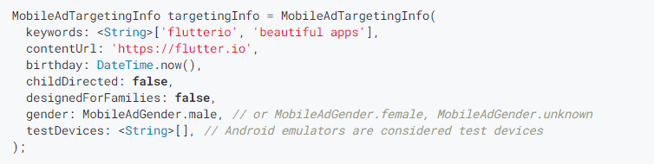
Implementation
Create MobileAdTargetingInfo
Notes:
next we go to the pubspec.yaml and add the dependencie for our package
after doing this we go to the main.dart and click the dependencies
now we can start to program the ads

Slide 13
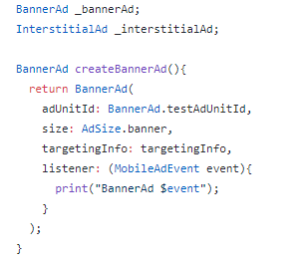
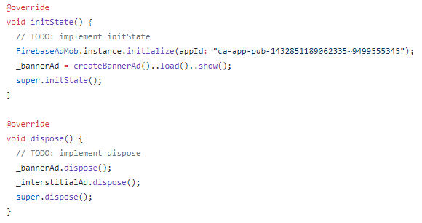
Implementation
Create a BannerAd Initialize and dispose your ad
Notes:
next we go to the pubspec.yaml and add the dependencie for our package
after doing this we go to the main.dart and click the dependencies
now we can start to program the ads

Slide 14

Implementation
Start your app with your emulator or smartphone
Select your emulator or smartphone
Notes:
next we go to the pubspec.yaml and add the dependencie for our package
after doing this we go to the main.dart and click the dependencies
now we can start to program the ads

